Slide 1
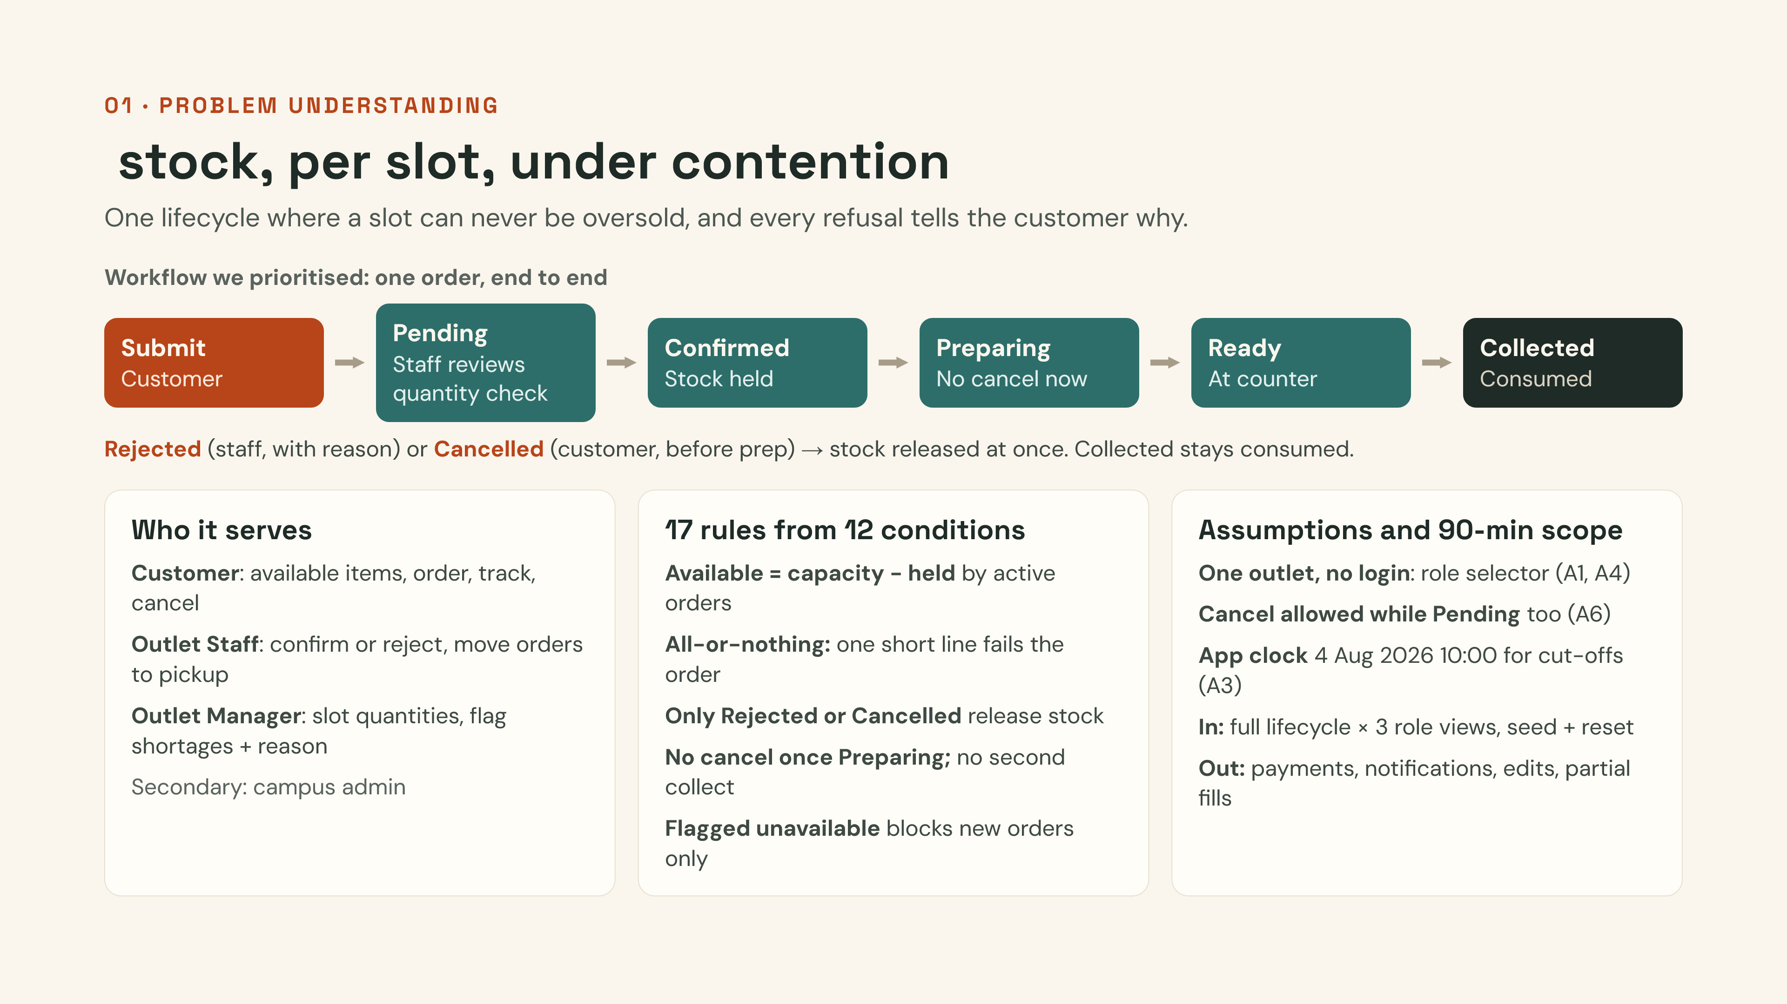
Notes:
Open with the reframe: this is not "ordering food online", it is managing scarce, slot-bound stock that many people compete for, with a state machine on top. Three personas, each gets its own view: customer, outlet staff, outlet manager. Walk the workflow left to right: submit reserves stock immediately, staff confirm, prep, ready, collected. Only Rejected and Cancelled give stock back; Collected is consumed. We turned the brief's 12 business conditions into 17 numbered rules, each traceable in the README. Call out the key assumptions: one outlet, no login (role selector), customer can also withdraw a pending order (A6), and an app clock fixed to the demo date so slot cut-offs still work. Scope: the full lifecycle across three views; payments, notifications, editing orders and partial fulfilment are deliberately out.

Slide 2
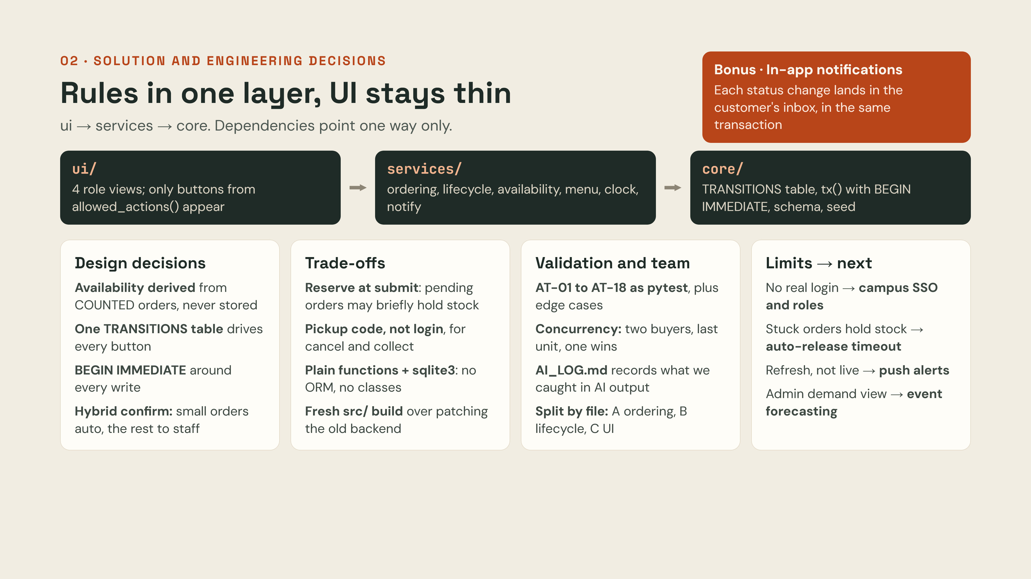
Notes:
Architecture: three layers with dependencies pointing one way. ui/ is Streamlit only and never touches SQL; services/ holds every business rule and never imports Streamlit; core/ holds the shared contracts: the TRANSITIONS table, the database helper and the seed. Because buttons come from allowed_actions(), which reads the same table, the UI can never offer an illegal move. Key decisions: availability is derived on every read from orders in the COUNTED statuses, so it cannot drift; every write runs inside tx(), which opens BEGIN IMMEDIATE, so two customers cannot both take the last unit; confirmation is hybrid: small orders auto-confirm, larger ones go to staff review. Trade-offs: stock is reserved at submit, so a pending order may hold stock that is later rejected, but nobody is confirmed for food that is gone; customers use a pickup code instead of a login; plain functions and sqlite3 keep every file explainable; we rebuilt cleanly in src/ instead of patching the older backend, which stored a counter and did not reserve atomically. Validation: AT-01 to AT-18 are pytest tests, including a concurrency test, and AI_LOG.md records the AI suggestions we caught and corrected. Each member owns separate files: A data and ordering, B rules and lifecycle, C the UI and docs. Bonus: in-app notifications written in the same transaction as the status change. Close with limits and next steps.

